Slide 1



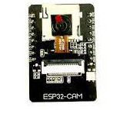
Midterm Presentation Project Title
Students: Yael Tzadik, Eden Ishay
Supervisor: Johanan Erez
Context: Project A
Date: 1/2023
[Optional Picture]

Slide 2
Presentation Outline
Overview of the component
Existing Projects
Available IDEs
ffff

Slide 3
Project Goal
Building a facial recognition system for opening doors based on existing algorithms
Developing anti spoofing algorithm using the existing hardware in the ESP32-cam component.
Performance evaluation of ESP32CAM in the context of image processing

Slide 4
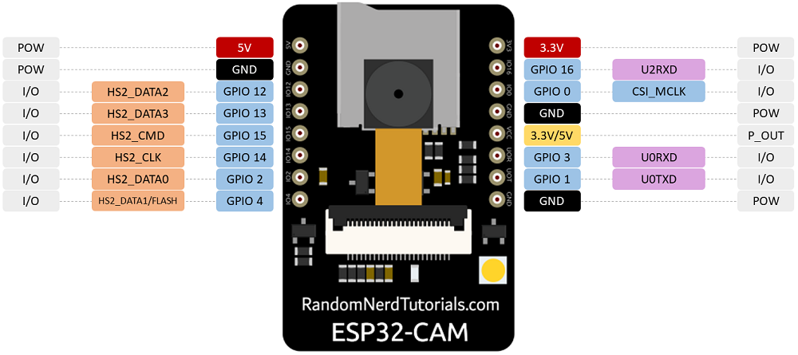
Background
520KB SRAM +4M PSRAM | RAM
802.11 b/g/n/ | Wi-Fi
Maximum support 4G | Support TF card
JPEG( OV2640 support only ), BMP, GRAYSCALE | Image Output Format
2412 ~2484MHz | Spectrum Range

Slide 5
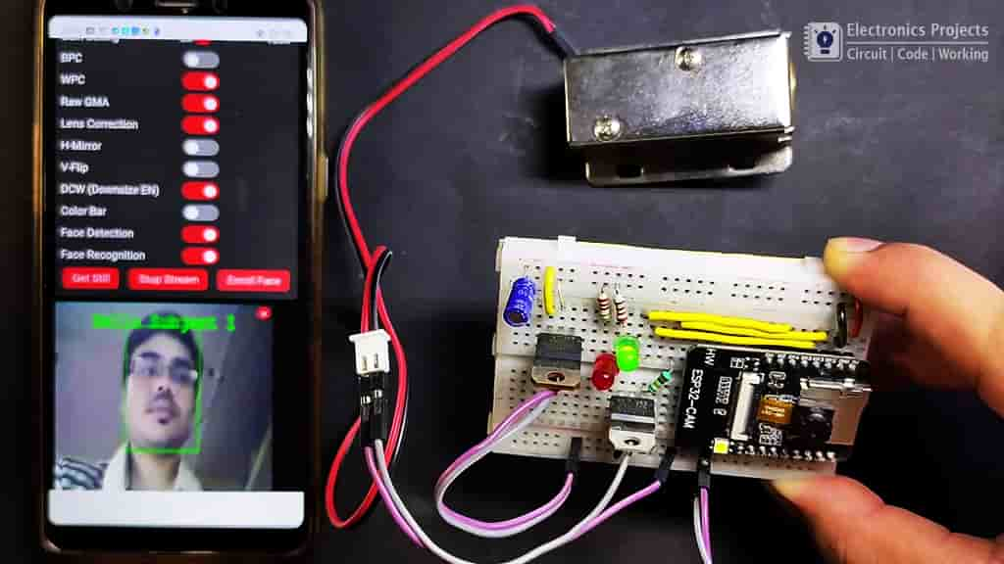
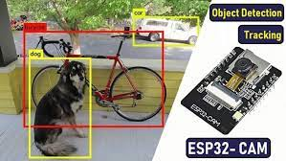
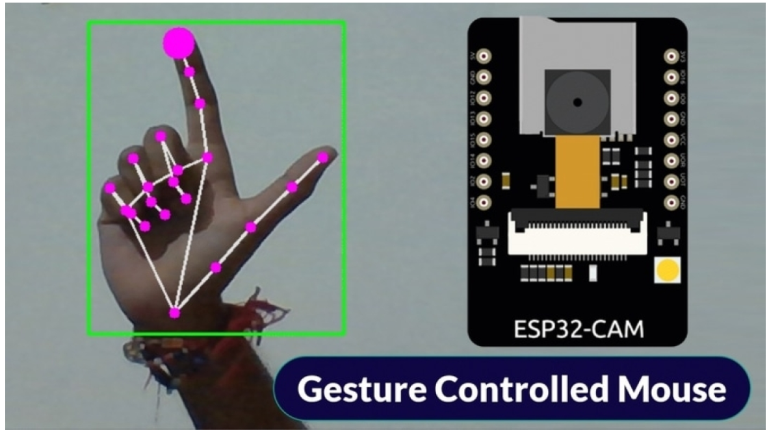
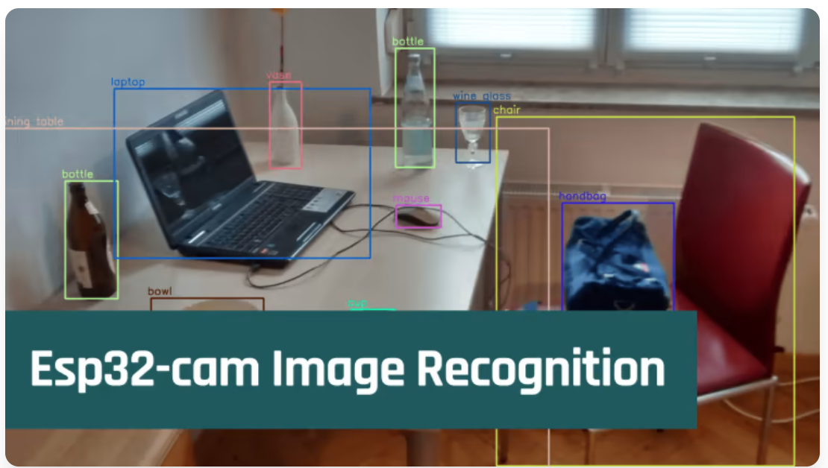
Existing Projects

Slide 6
Background
Arduino IDE
Espressif ESP-IDF
Well known environment
Support for the basic libraries of the component
Does not support significant image processing libraries
Extension to VS Code or Eclipse IDE
Relatively new, more flexible IDE
Theoretically supports the basic libraries of the component and the OpenCV library

Slide 7
Optional Solutions
Describe in more details existing relevant solution(s) for the problem – general description, algorithms, systems, pro’s Vs. Con’s (quality, cost, complexity…) etc.

Slide 8
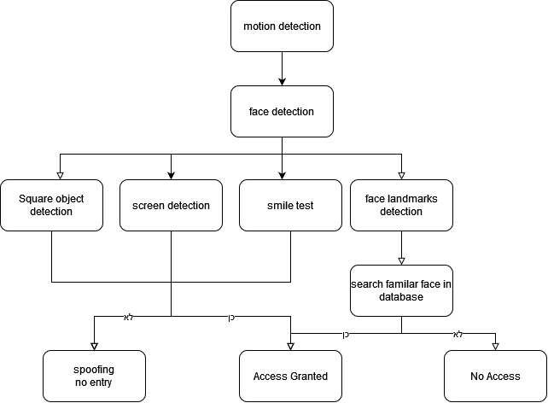
Optional Solutions
Describe in more details existing relevant solution(s) for the problem – general description, algorithms, systems, pro’s Vs. Con’s (quality, cost, complexity…) etc.

Slide 9
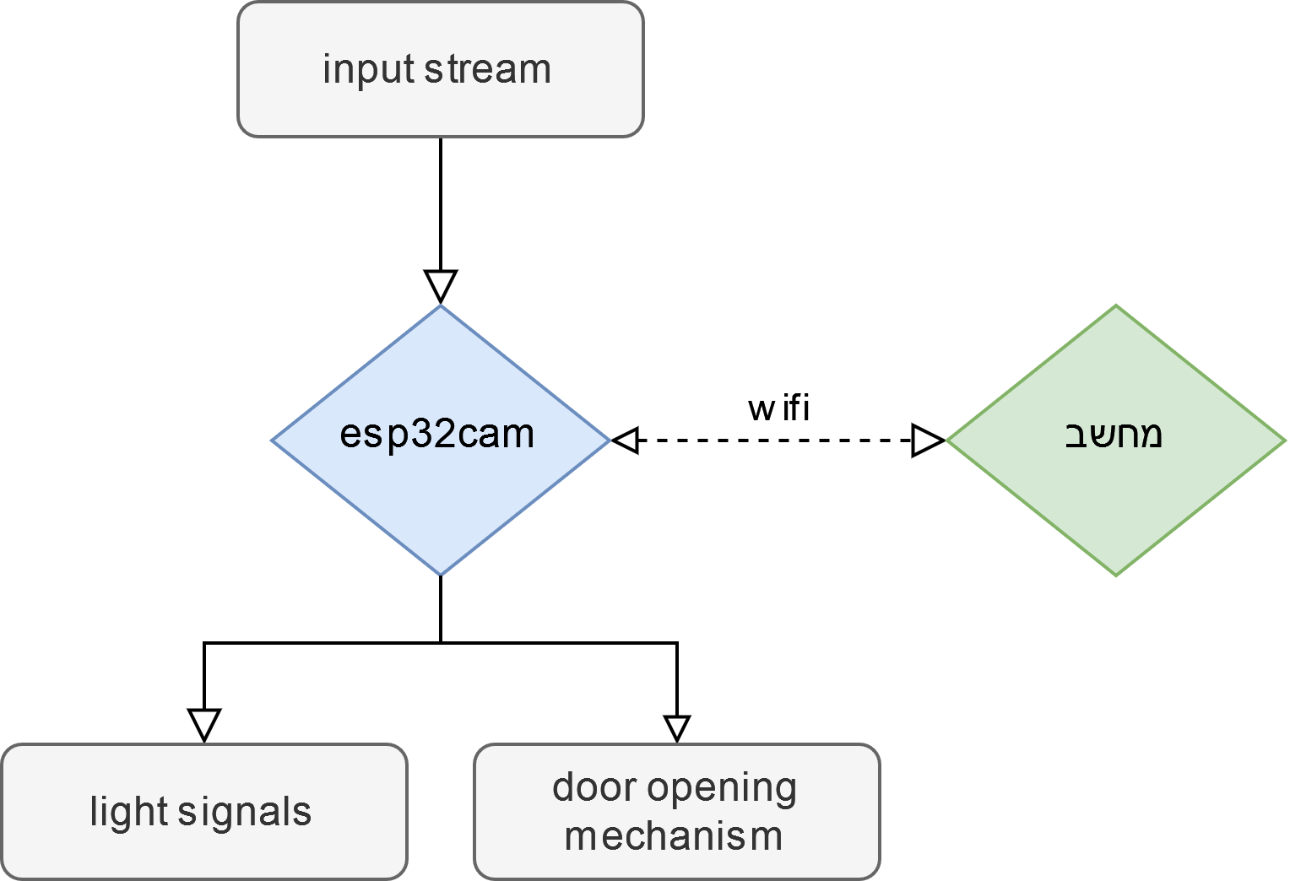
Chosen solution: Block Diagram

Slide 10
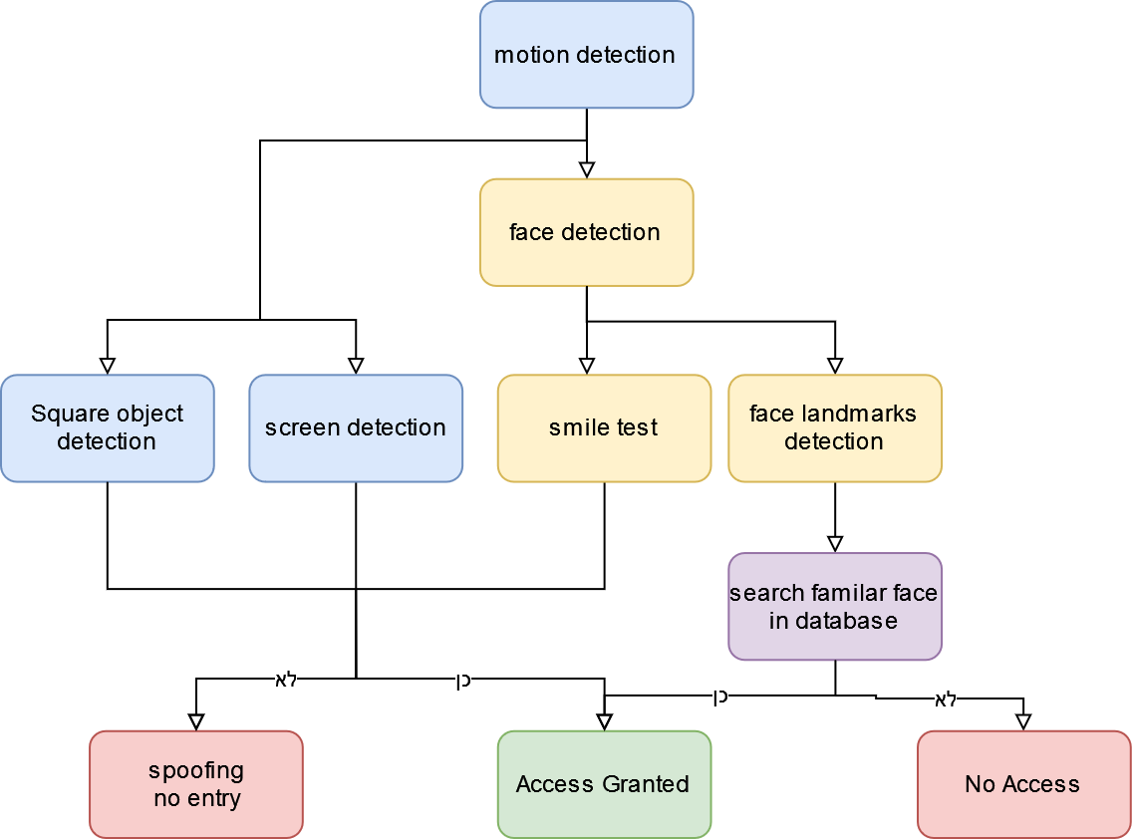
Chosen solution: Block Diagram

Slide 11

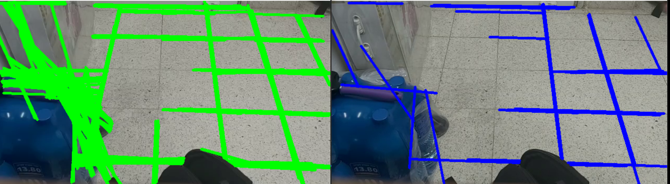
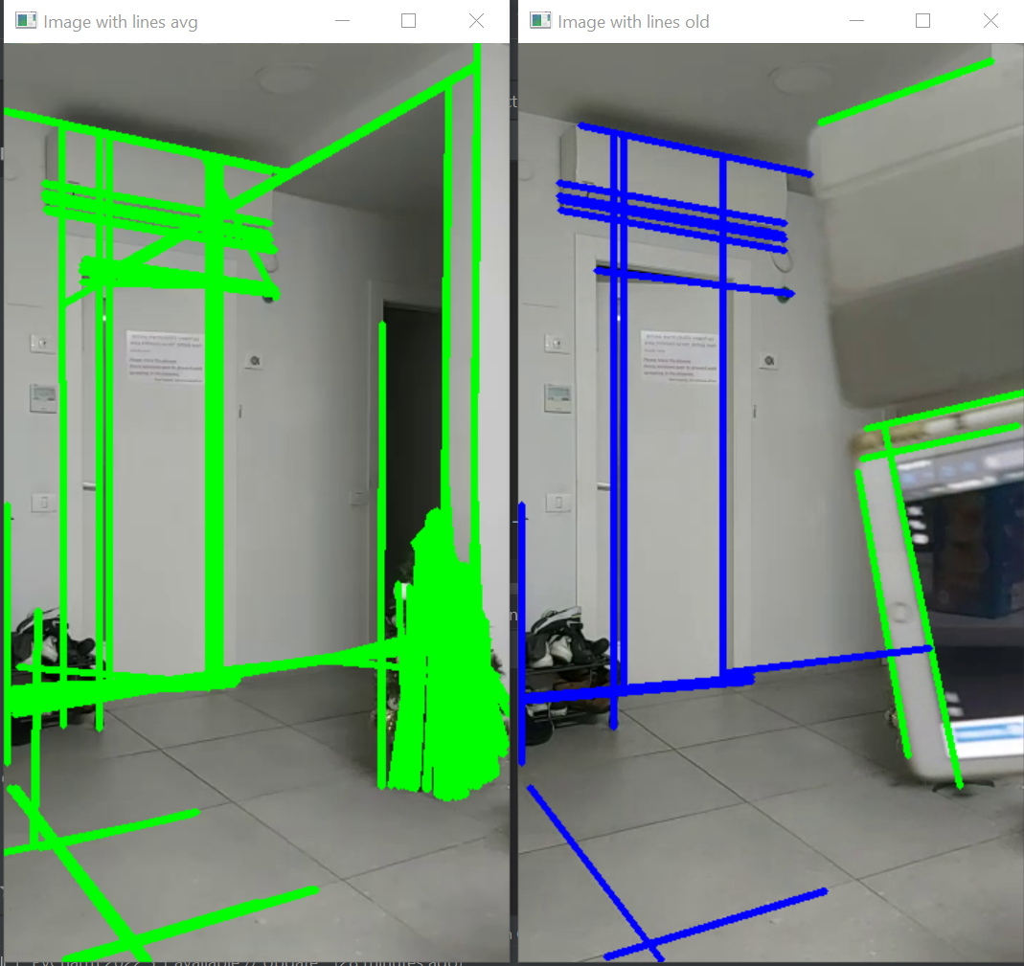
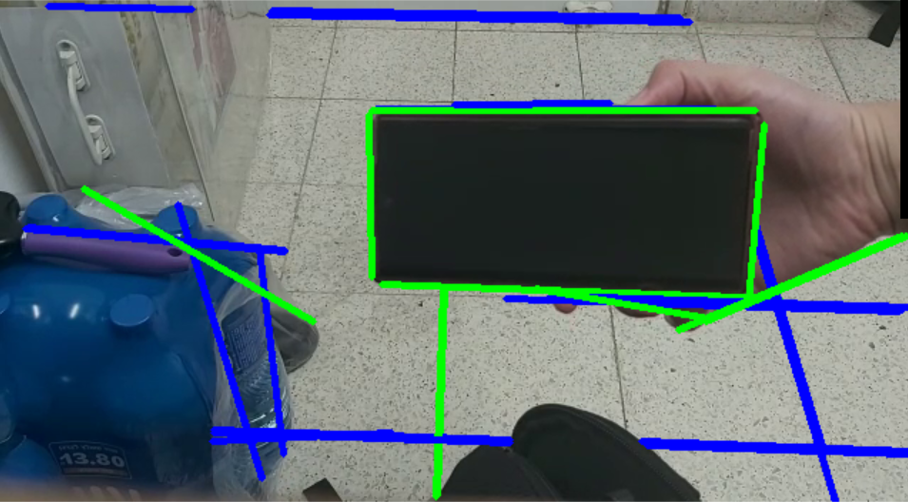
Chosen solution: details
Square object detection
Using the Hough transform
No movement - learning the rectangular objects in the background
Movement - detection of new square objects

Slide 12
Chosen solution: details
Screen detection
Identifying the aliasing within the image by changing the camera's sample frequency

Slide 13
Chosen solution: details
Face landmarks
Detection
A detailed explanation about the chosen solution – a block diagram is a very good way to start with, probably followed with a few more slides describing the solution and maybe more diagrams for details if needed
Face detection
A detailed explanation about the chosen solution – a block diagram is a very good way to start with, probably followed with a few more slides describing the solution and maybe more diagrams for details if needed

Slide 14
Chosen solution: details
Smile test
A detailed explanation about the chosen solution – a block diagram is a very good way to start with, probably followed with a few more slides describing the solution and maybe more diagrams for details if needed
Search of familiar face In database
A detailed explanation about the chosen solution – a block diagram is a very good way to start with, probably followed with a few more slides describing the solution and maybe more diagrams for details if needed
Motion detection
Using OpenCV motion detection

Slide 15
Chosen solution: details
Explanations of the solution and the block diagram from the previous slide –

Slide 16
Results so Far
Present your results – the output of your system with comparison to other systems so you can show what you do better than others

Slide 17
Summary
A short summary of the work – main points in the implementation , achievements, original contribution etc.

Slide 18
Conclusions
Explain in short what can be learned from your results, future work you think can be done etc.

Slide 19
References
Only most important references should be mentioned here, in the following form:
[#] Author name(s), Title, Publisher (conference/Magazine) , Year

